Slide 1
Smart Energy Monitoring
System Design
Guide:
K. R. Sravan Kumar
Team Members:
Karthikeyan P – 14A91A1226
Venkata Sai T.D – 14A91A1241
Ravi Raj S – 14A91A1239
Saranya Y.K.V.L – 14A91A1242

Slide 2
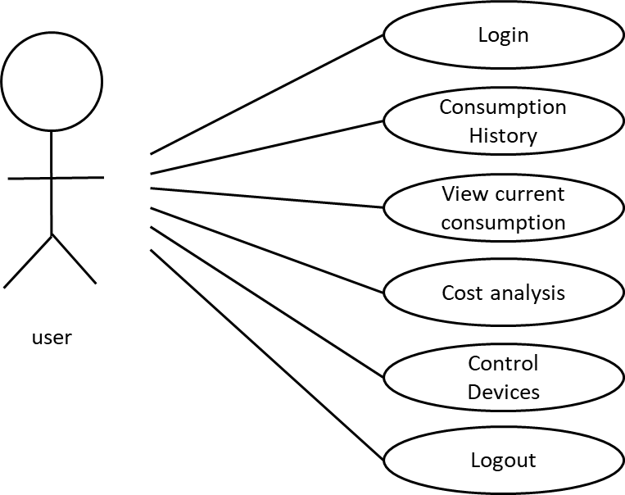
Use case diagram

Slide 3
Interaction / Sequence diagram
Specifies the sequential procedure followed the system to start and perform operations that are requested by the user

Slide 4
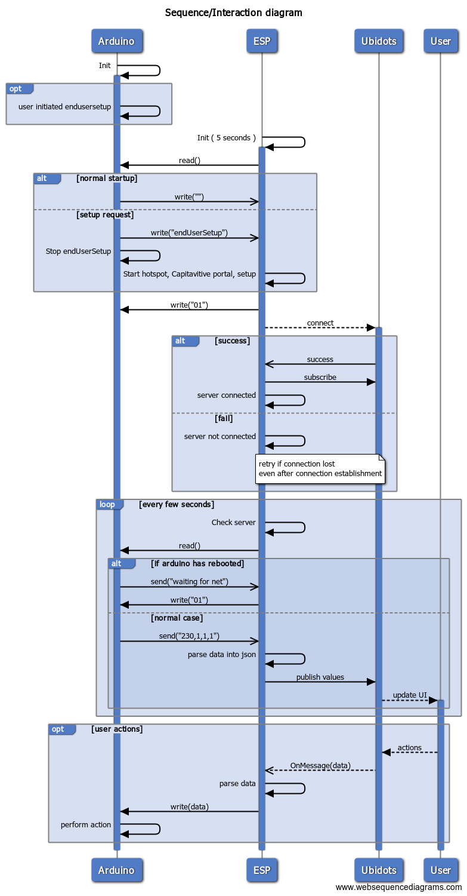

Slide 6
Thank you
Questions?

